Slide 1


<Dr. Chun Kong Mak>
<18th July 2024>

Slide 2

Outline
Executive Summary
Introduction
Methodology
Results
Conclusion
Appendix

Slide 3
Executive Summary
Summary of methodologies:
In this project, data collection is achieved by SpaceX API. Data is cleaned up. Exploratory data analysis (EDA) using visualization SQL are performed. Interactive visual analytics using Folium and Plotly Dash are carried out. At the end, predictive analysis using classification models is done.
Summary of all results
From EDA through visualization:
At CCAFS LC-40, success rate increases when flight number is more than 40. At VAFB SLC 4E, success rate increases when flight number is more than 20.
At VAFB-SLC launch site, there are no rockets launched for heavy payload mass (greater than 10000kg).
Which orbits have high success rate? VLEO: > 0.8. SSO, HEO, GEO and ES-L1 gives 100% success rate.
In the LEO orbit, the success appears related to the number of flights. Success increases when flight number increases. In the GTO orbit, there seems to be no relationship between flight number and success.
With heavy payloads, the successful landing or positive landing rate are more for the Polar, LEO and ISS orbits.
Success rate kept increasing since 2013 till 2020.

Slide 4
Executive Summary
Summary of all results
From EDA through SQL:
There are four unique sites namely CCAFS LC-40, VAFB SLC-4E, KSC LC-39A and CCAFS SLC-40.
Total payload mass carried by boosters launches by NASA (CRS) is 45596kg.
The average Payload mass from Booster Version F9 v1.1 is 2928.4kg.
The first successful landing was on 8th April 2016.
There are three unique Booster versions namely F9 FT B1032.1, F9 B4 B1040.1 and F9 B4 B1043.1 when the landing was successful and the payload mass was between 4000 and 6000 kg.
The number of successful mission outcomes was 100 while the number of failed outcome was 1.
Booster Versions with maximum payload mass were F9 B5 B1048.4, F9 B5 B1049.4, F9 B5 B1051.3, F9 B5 B1056.4, F9 B5 B1048.5, F9 B5 B1051.4, F9 B5 B1049.5, F9 B5 B1060.2, F9 B5 B1058.3, F9 B5 B1051.6, F9 B5 B1060.3, F9 B5 B1049.7.

Slide 5
Executive Summary
Summary of all results
Folium map:
There are in total 56 launch sites. All of them are in United States. 10 of them are on the west coast while 46 of them are on the east coast.
All launch sites are close to the coast line.
Plotly Dashboard:
Launch site KSC LC-39A has the highest successful rate i.e. 41.7% among all the four sites.
In the site KSC LC-39A, there are 76.9% success outcome and 23.1% failed outcome.
Site CCAFS LC-40: 26.9% success, 73.1% fail. Success occurs only with FT Booster Version with PayLoad Mass over 2000kg.
Site CCAFS SLC-40: 42.9% success, 57.1% fail. Success rate seems higher when PayLoad Mass is under 4000kg and it doesn’t seem to be dependent on Booster Version.
Site KSC LC-39A: 23.1% success, 76.9% fail. Success occurs only with PayLoad Mass under 5500kg and independent of Booster Version
Site VAFB SLC-4E: 40% success, 60% fail. Success and failure rate seem to be unrelated to PayLoad Mass nor the Booster Version.

Slide 6
Introduction
Project background and context
In this capstone project, we will predict if the Falcon 9 first stage will land successfully. SpaceX advertises Falcon 9 rocket launches on its website with a cost of 62 million dollars; other providers cost upward of 165 million dollars each, much of the savings is because SpaceX can reuse the first stage. Therefore if we can determine if the first stage will land, we can determine the cost of a launch. This information can be used if an alternate company wants to bid against SpaceX for a rocket launch.
Problems you want to find answers
What are the factors that increase the successful landing rate?

Slide 7

Section 1

Slide 8
Methodology
Executive Summary
Data collection methodology:
SpaceX launch data was collected by making a get request to SpaceX API.
Perform data wrangling
Data was filtered to have only records from BoosterVersion = Falcon 9. Missing data of the PayLoadMass was replaced by the mean of the PayLoadMass. Number of launches is calculated on each launching site. Number and occurrence of each orbit is calculated. The number of occurrence of mission outcome per orbit type is calculated. When the landing outcome is successful, “1” is assigned to the class. If not successful, “0” is assigned to the class. Hence, success rate 67% is calculated among 90 landings while 30 failed landings occurred.
Perform exploratory data analysis (EDA) using visualization and SQL
Perform interactive visual analytics using Folium and Plotly Dash
Perform predictive analysis using classification models
Class of “1” or “0” is created as a column to represent the successful outcome as “1” and unsuccessful outcome as “0”. The data was standardized and split into training data and test data. The best Hyperparameter was determined for four models i.e. SVM, Classification Trees, Logistic Regression and K-nearest neighbors. All models achieved the same test accuracy of 83.3%. Classification Tree model provides the highest validation accuracy 90.4%, which suggests it performed better on the validation data during hyperparameter tuning. It performs the best based on the hyperparameter tuning results and validation accuracy.

Slide 9
Data Collection
Describe how data sets were collected.
You need to present your data collection process use key phrases and flowcharts

Slide 10
Data Collection – SpaceX API
Present your data collection with SpaceX REST calls using key phrases and flowcharts
Add the GitHub URL of the completed SpaceX API calls notebook (must include completed code cell and outcome cell), as an external reference and peer-review purpose: https://github.com/ckmak9999/ibm_datascience_capstone/blob/cd10996168de6951d98f7e22d00d9679bf702a5b/1_1_jupyter-labs-spacex-data-collection-api.ipynb
API: url = https://api.spacexdata.com/v4/launches/past
Response = requests.get(url)
Response.json()
Ison_normalize

Slide 11
Data Collection - Scraping
Present your web scraping process using key phrases and flowcharts
Here is the GitHub URL of the completed web scraping notebook, as an external reference and peer-review purpose: https://github.com/ckmak9999/ibm_datascience_capstone/blob/cd10996168de6951d98f7e22d00d9679bf702a5b/1_2_jupyter-labs-webscraping.ipynb
Request Wikipedia URL
https://en.wikipedia.org/wiki/List_of_Falcon_9_and_Falcon_Heavy_launches
Web scraping with BeautifulSoup
Convert to Panda dataframe

Slide 12
Data Wrangling
Describe how data were processed
You need to present your data wrangling process using key phrases and flowcharts
Add the GitHub URL of your completed data wrangling related notebooks, as an external reference and peer-review purpose:
https://github.com/ckmak9999/ibm_datascience_capstone/blob/cd10996168de6951d98f7e22d00d9679bf702a5b/1_3_labs-jupyter-spacex-data_wrangling_jupyterlite.jupyterlite.ipynb
Filter data only Falcon 9
Replace missing data of PayLoadMass by Mean of PayLoadMass
Calculate number of launches on each site
When outcome is successful, class = “1”
When outcome is not successful, class = “0”
Notes:
Data was filtered to have only records from BoosterVersion = Falcon 9. Missing data of the PayLoadMass was replaced by the mean of the PayLoadMass. Number of launches is calculated on each launching site. Number and occurrence of each orbit is calculated. The number of occurrence of mission outcome per orbit type is calculated. When the landing outcome is successful, “1” is assigned to the class. If not successful, “0” is assigned to the class.

Slide 13
EDA with Data Visualization
Summarize what charts were plotted and why you used those charts
Scatter plot: Flight Number versus Pay Load Mass (kg), overlay outcome of launch → Flight number increases, land success increases. Payload mass increases, success decreases.
Scatter plot: Launch Site versus Flight Number, overlay outcome of launch → Different launch sites have different success rates.
Scatter plot: Launch Site versus Pay Load Mass (kg), overlay outcome of launch → VAFB-SLC launchsite, no rockets launched for heavy payload mass (> 10000kg).
Bar chart: Orbit Type versus Success Rate → which orbits have high success rate?
Scatter plot: Orbit versus Flight Number, overlay outcome of launch→ Relationship between Flight Number and Orbit Type
Scatter plot: Payload Mass versus Orbit Type, overlay outcome of launch→ Relationship between PayLoad Mass and Orbit Type
Line plot: Success rate versus Date → success rate increases since 2013 until 2020.

Slide 14
EDA with Data Visualization
Add the GitHub URL of your completed EDA with data visualization notebook, as an external reference and peer-review purpose
https://github.com/ckmak9999/ibm_datascience_capstone/blob/cd10996168de6951d98f7e22d00d9679bf702a5b/2_2_jupyter-labs-eda-dataviz.ipynb.jupyterlite.ipynb

Slide 15
EDA with SQL
Using bullet point format, summarize the SQL queries you performed
Task 1: %sql select DISTINCT Launch_Site from SPACEXTBL
Task 2: %sql select * from SPACEXTBL where Launch_Site like "KSC%" LIMIT 5
Task 3: %sql select SUM("PAYLOAD_MASS__KG_") AS total_payload_mass from SPACEXTBL where Customer = "NASA (CRS)“
Task 4: %sql select AVG(PAYLOAD_MASS__KG_) as Average_Payload_Mass from SPACEXTBL where Booster_Version = "F9 v1.1“
Task 5: %sql select min(Date) as date_successful_landing from SPACEXTBL where "Landing_Outcome" = "Success (drone ship)“
Task 6: %sql select DISTINCT Booster_Version from SPACEXTBL where "Landing_Outcome" = "Success (ground pad)" and "PAYLOAD_MASS__KG_" > 4000 and "PAYLOAD_MASS__KG_" < 6000
Task 7: %sql select count(*) as num_successful_outcomes from SPACEXTBL where "Mission_Outcome" like "Success%“
%sql select count(*) as num_failure_outcomes from SPACEXTBL where "Mission_Outcome" like "Failure%“
Task 8: %sql select distinct Booster_Version from SPACEXTBL where "PAYLOAD_MASS__KG_" = (Select MAX("PAYLOAD_MASS__KG_") from SPACEXTBL)
Task 9: %sql SELECT substr("Date", 6, 2) AS Month_Number, Landing_Outcome, Booster_Version, Launch_Site FROM SPACEXTBL WHERE substr("Date", 0, 5) = '2017'AND Landing_Outcome LIKE 'Success%‘
Task 10: %sql SELECT Landing_Outcome, COUNT(*) AS Outcome_Count FROM SPACEXTBL WHERE "Date" BETWEEN '2010-06-04' AND '2017-03-20' group by Landing_Outcome ORDER BY Outcome_Count DESC

Slide 16
EDA with SQL
Add the GitHub URL of your completed EDA with SQL notebook, as an external reference and peer-review purpose
https://github.com/ckmak9999/ibm_datascience_capstone/blob/766566d290a157276c54dee35c6dfb8ebf0b1f31/2_1_jupyter-labs-eda-sql-edx_sqllite.ipynb

Slide 17
Build an Interactive Map with Folium
Summarize what map objects such as markers, circles, lines, etc. you created and added to a folium map
Explain why you added those objects
Folium.Circle: create for NASA Johnson Space Center
Folium.map.Marker: to add coordinate and information of the spot. Add color of the marker to show successful outcome or not.
Folium.Polyline: to show the calculated distance between the launch site and other objects such as closest city, railway, highway, coastline.
Add the GitHub URL of your completed interactive map with Folium map, as an external reference and peer-review purpose
https://github.com/ckmak9999/ibm_datascience_capstone/blob/766566d290a157276c54dee35c6dfb8ebf0b1f31/3_1_lab_jupyter_launch_site_location.jupyterlite.ipynb
Notes:
Summarize what map objects such as markers, circles, lines, etc. you created and added to a folium map
Explain why you added those objects

Slide 18
Build a Dashboard with Plotly Dash
Summarize what plots/graphs and interactions you have added to a dashboard
Pie chart of total success launches for all sites, indicating the relative ratio of success rates among four launch sites. Hovering on the chart displays the launch site name and number of data points
Pie chart displaying the total success launches for each of the four individual sites. It shows % of success and fail. Hovering on the chart displays the value of class and number of data points.
Range slider: x-axis is PayLoad Mass (kg). y-axis is class (1 or 0). The color code legend indicates Booster Version.
Explain why you added those plots and interactions
The plots and interactions provide us insights of: which launch site has more success rate? In each launch site, are Booster Version and PayLoad Mass (kg) related to the success rate?
Add the GitHub URL of your completed Plotly Dash lab, as an external reference and peer-review purpose
https://github.com/ckmak9999/ibm_datascience_capstone/blob/766566d290a157276c54dee35c6dfb8ebf0b1f31/3_2_spacex_dash_app.py

Slide 19
Predictive Analysis (Classification)
Load dataset generated from EDA
Split data into training data and testing data sets. Test data set is 20%.
Apply four models separately
Logistic Regression
Support vector machine (SVM)
Decision tree classifier
K nearest neighbors
Determine and compare
Tuned hyperparameters
Accuracy on validation data
Accuracy on the test data
Confusion matrix
Which model is the best?
Add the GitHub URL of your completed predictive analysis lab, as an external reference and peer-review purpose
https://github.com/ckmak9999/ibm_datascience_capstone/blob/766566d290a157276c54dee35c6dfb8ebf0b1f31/4_1_SpaceX_Machine_Learning_Prediction_Part_5.jupyterlite.ipynb
Notes:
Summarize how you built, evaluated, improved, and found the best performing classification model
You need present your model development process using key phrases and flowchart

Slide 20
Results
Exploratory data analysis results
Interactive analytics demo in screenshots
Predictive analysis results

Slide 21

Section 2

Slide 22
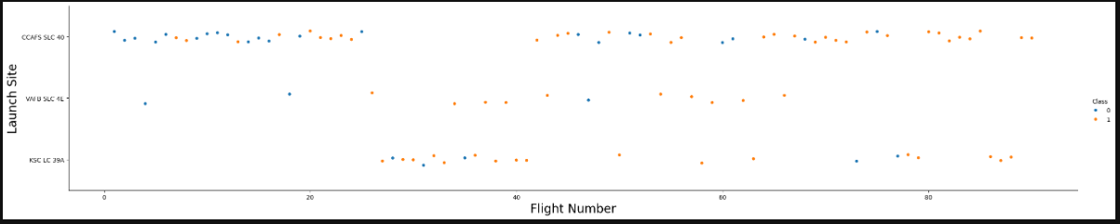
Flight Number vs. Launch Site
Show a scatter plot of Flight Number vs. Launch Site
Show the screenshot of the scatter plot with explanations
Different launch sites have different success rates dependent on the Flight Number.
At CCAFS LC-40, success rate increases when flight number is more than 40.
At VAFB SLC 4E, success rate increases when flight number is more than 20.

Slide 23
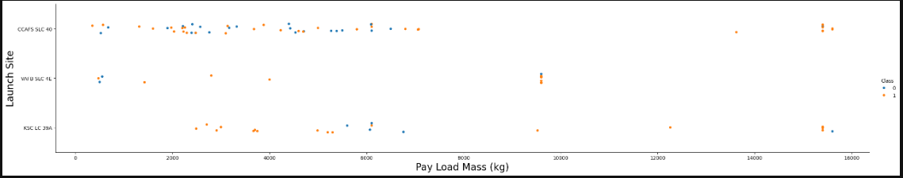
Payload vs. Launch Site
Show a scatter plot of Payload vs. Launch Site
Show the screenshot of the scatter plot with explanations
At VAFB-SLC launch site, there are no rockets launched for heavy payload mass (greater than 10000kg).

Slide 24
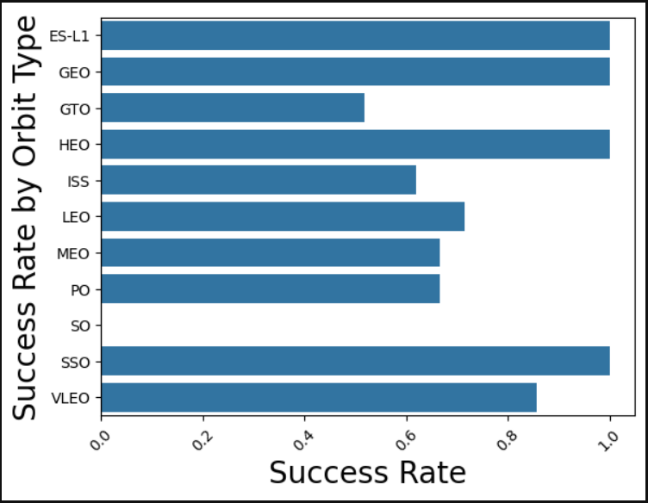
Success Rate vs. Orbit Type
Show a bar chart for the success rate of each orbit type
Show the screenshot of the scatter plot with explanations
Which orbits have high success rate?
VLEO: > 0.8
SSO, HEO, GEO and ES-L1 gives 100% success rate.

Slide 25
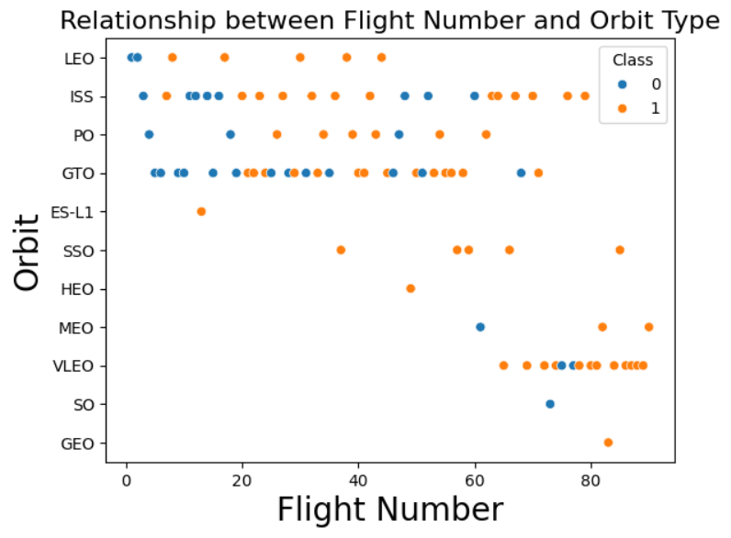
Flight Number vs. Orbit Type
Show a scatter point of Flight number vs. Orbit type
Show the screenshot of the scatter plot with explanations
In the LEO orbit, the success appears related to the number of flights. Success increases when flight number increases.
In the GTO orbit, there seems to be no relationship between flight number and success.

Slide 26
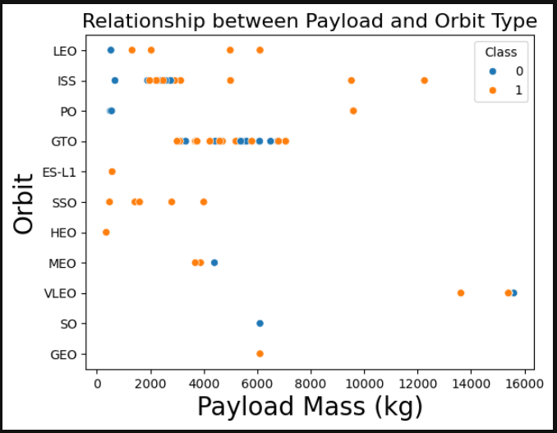
Payload vs. Orbit Type
Show a scatter point of payload vs. orbit type
Show the screenshot of the scatter plot with explanations
With heavy payloads, the successful landing or positive landing rate are more for the Polar, LEO and ISS orbits.

Slide 27
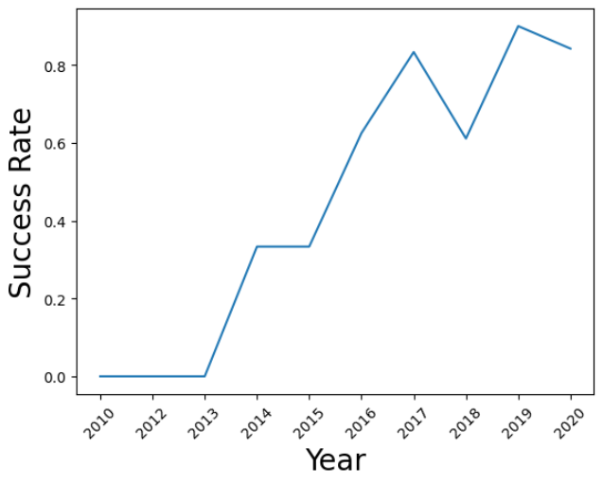
Launch Success Yearly Trend
Show a line chart of yearly average success rate
Show the screenshot of the scatter plot with explanations
Success rate kept increasing since 2013 till 2020.

Slide 28
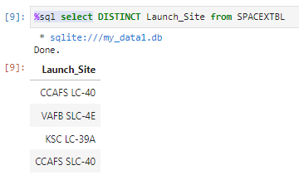
All Launch Site Names
Use SQL command to find the distinct launch_site record from the SPACEXTBL database
Notes:
Find the names of the unique launch sites
Present your query result with a short explanation here

Slide 29
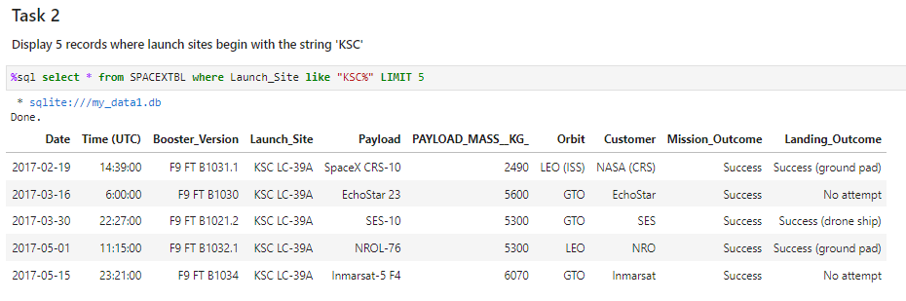
Launch Site Names Begin with 'KSC'
Use SQL to search all records from SPACEXTBL when the launch_site has words starting with ‘KSC’. Limit to display the top five entries.
Notes:
Find 5 records where launch sites’ names start with `KSC`
Present your query result with a short explanation here

Slide 30
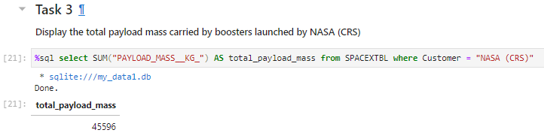
Total Payload Mass
Sum all the “payload_mass_kg” and save it into a value named total_payload_mass from the SPACEXTBL database. Where the customer has string “NASA (CRS)”
Notes:
Calculate the total payload carried by boosters from NASA
Present your query result with a short explanation here

Slide 31
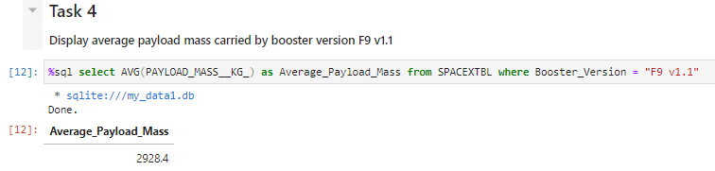
Average Payload Mass by F9 v1.1
Use SQL to calculate the average value of “PAYLOAD_MASS__KG_” and store it into a value named Average_Payload_Mass from the database SPACEXTBL where the “Bosster_Version” equals to the string “F9 v1.1”.
Notes:
Calculate the average payload mass carried by booster version F9 v1.1
Present your query result with a short explanation here

Slide 32
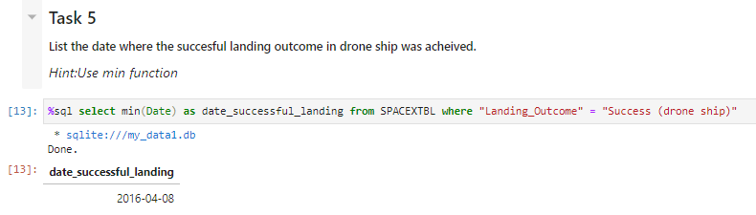
First Successful Ground Landing Date
Find the minimum value of Date and store it into a value named date_successful_landing from the database SPACEXTBL where the value “Landing_Outcome” equals to “Success (drop Ship)”
Notes:
Find the dates of the first successful landing outcome on drone ship.
Present your query result with a short explanation here

Slide 33
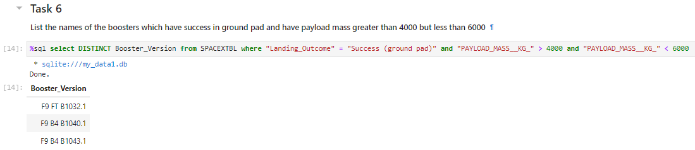
Successful Drone Ship Landing with Payload between 4000 and 6000
Use SQL to find the distinct unique values of “Booster_Version” from the database SPACEXTBL where the value “Landing_Outcome” equals to string “Success (ground pad)” and “PAYLOAD_MASS__KG” > 4000 and “PAYLOAD_MASS__KG” < 6000
Notes:
List the names of boosters which have successfully landed on drone ship and had payload mass greater than 4000 but less than 6000
Present your query result with a short explanation here

Slide 34
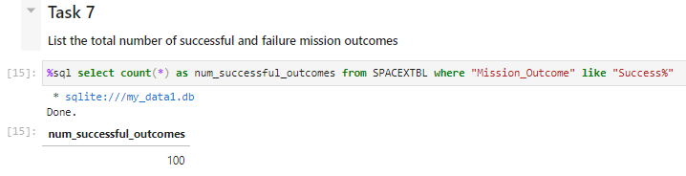
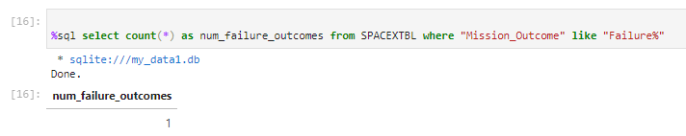
Total Number of Successful and Failure Mission Outcomes
Use SQL to count the total records, count(*), and store it into a value named “num_successful_outcomes” from the SPACEXTBL database where the value “Mission_Outcome” starts with string “Success”. Similarly to the failure outcomes
Notes:
Calculate the total number of successful and failure mission outcomes
Present your query result with a short explanation here

Slide 35
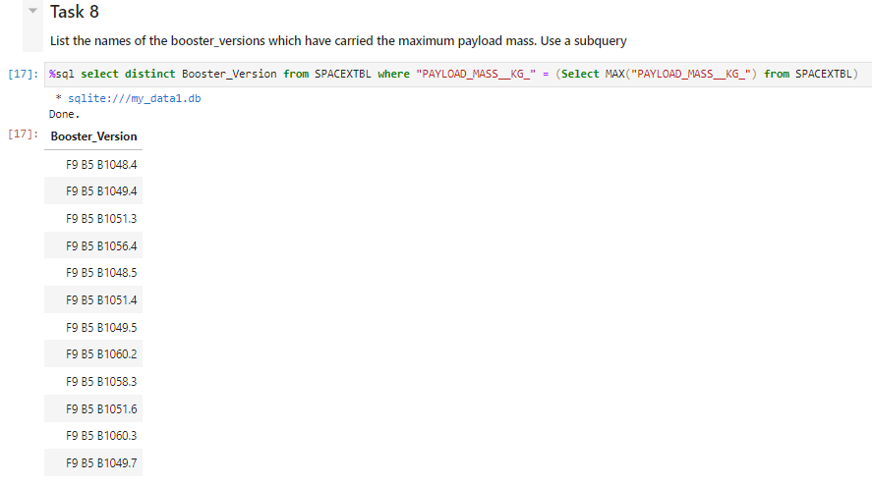
Boosters Carried Maximum Payload
Use SQL to search for distinct values of “Booster_Version” from the dataset SPACEXTBL where the “PAYLOAD_MASS__KG_” equals to the maximum value of “PAYLOAD_MASS__KG_”. Use compound SQL query to achieve.
Notes:
List the names of the booster which have carried the maximum payload mass
Present your query result with a short explanation here

Slide 36
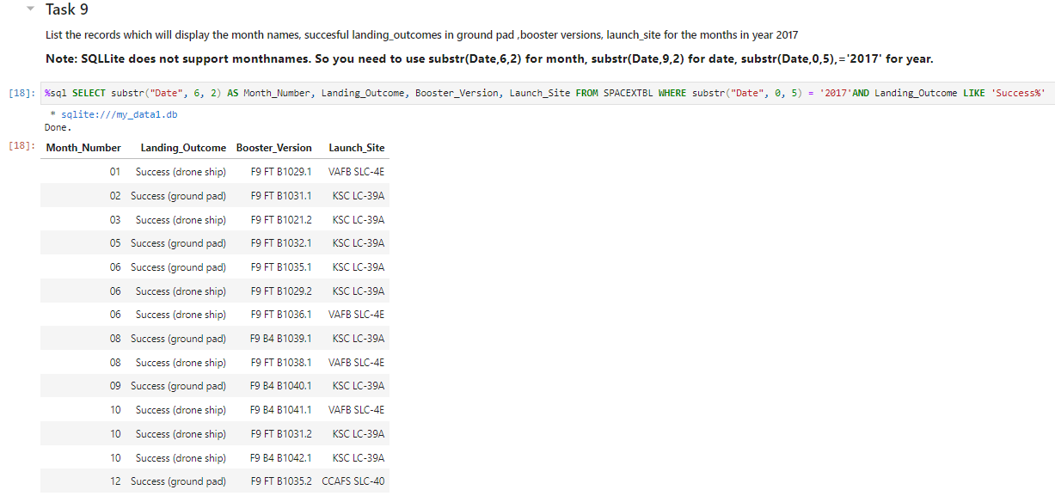
2015 Launch Records
Use SQL to get “substr(“Date”, 6, 2) and store it into value “Month_Number”, and get records of Landing_Outcome, Booster_Version and Launch_Site from the database SPACEXTBL where substr("Date", 0, 5) = '2017‘ and Landing_Outcome starts with string “Success”
Notes:
List the records which will display the month names, succesful landing_outcomes in ground pad ,booster versions, launch_site for the months in year 2017
Present your query result with a short explanation here

Slide 37
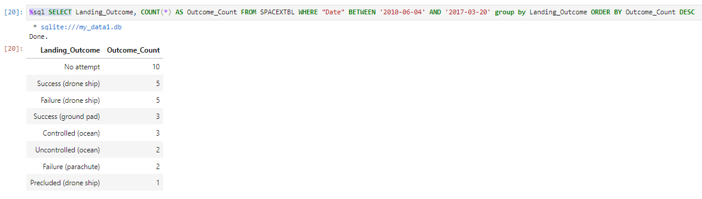
Rank Landing Outcomes Between 2010-06-04 and 2017-03-20
Use SQL to search records of Landing_Outcome, and count(*). Store count(*) into a value named Outcome_Count. From the database SPACEXTBL. Where "Date" BETWEEN '2010-06-04' AND '2017-03-20‘. Group the records by Landing_Outcome. Order by Outcome_Count descendingly.
Notes:
Rank the count of landing outcomes (such as Failure (drone ship) or Success (ground pad)) between the date 2010-06-04 and 2017-03-20, in descending order
Present your query result with a short explanation here

Slide 38

Section 3

Slide 39
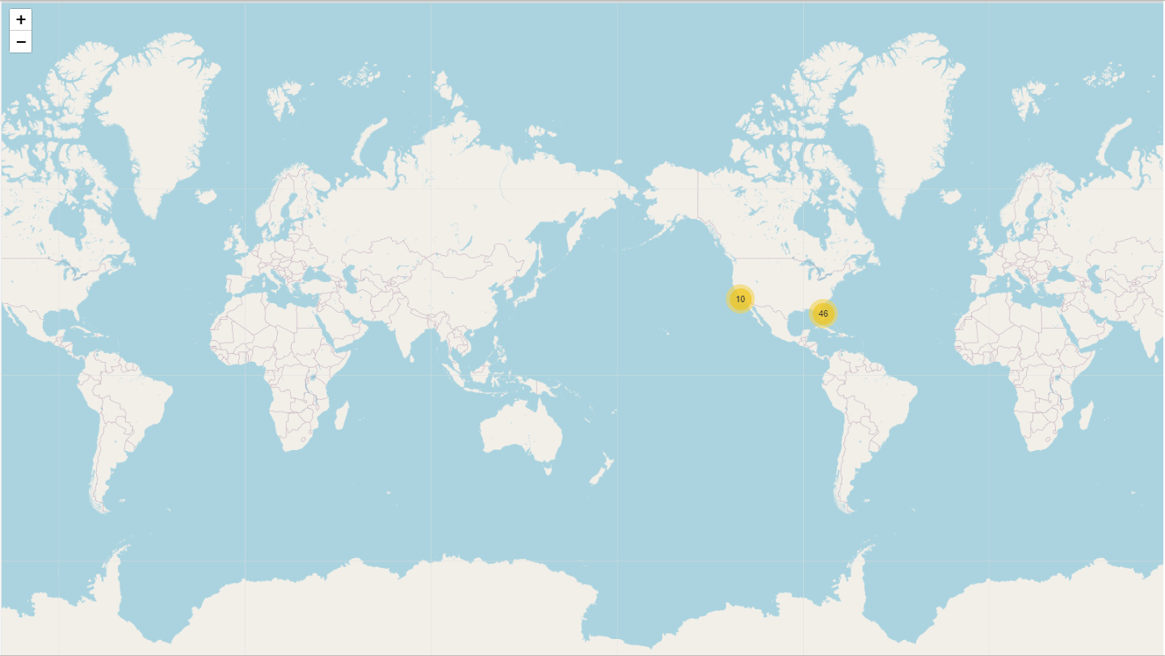
Launch Sites on a Global Map
There are in total 56 launch sites. All of them are in United States.
10 of them are on the west coast while 46 of them are on the east coast.
MarkerCluster object is represented by the yellow dots.
Notes:
Replace <Folium map screenshot 1> title with an appropriate title
Explore the generated folium map and make a proper screenshot to include all launch sites’ location markers on a global map
Explain the important elements and findings on the screenshot

Slide 40
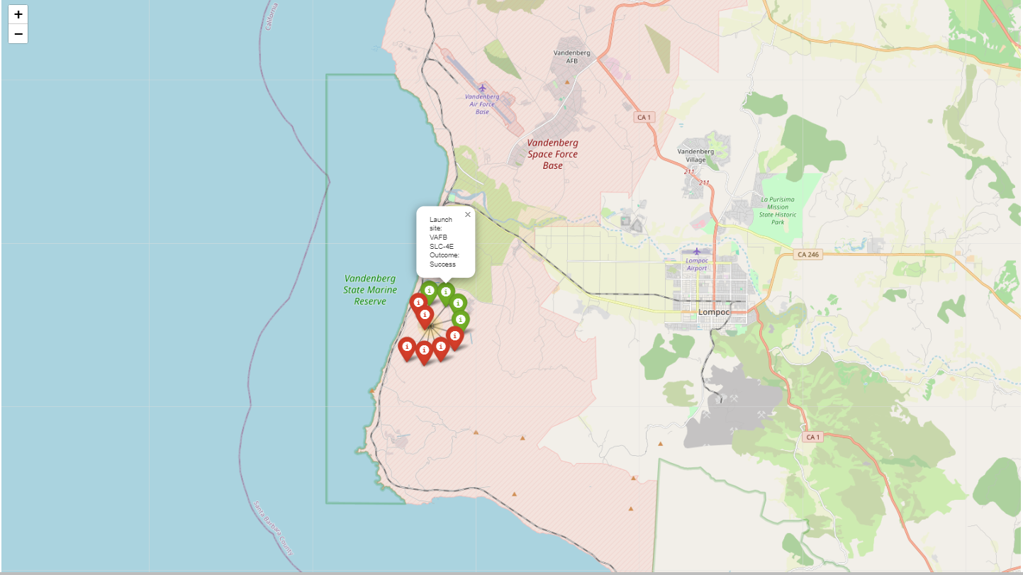
Map with color-labeled launch outcomes
Create a new column called “marker_color”.
Assign value “green” when launch_outcome is 1. Assign value “red” when launch_outcome is 0. Create MarkerCluster object. Add the Launch Site name, Lat, Long, marker color to the marker.
In the screenshot, for example, the launch site is VAFB SLC-4E. The dot is in green color when the launch outcome was successful.
Notes:
Replace <Folium map screenshot 2> title with an appropriate title
Explore the folium map and make a proper screenshot to show the color-labeled launch outcomes on the map
Explain the important elements and findings on the screenshot

Slide 41
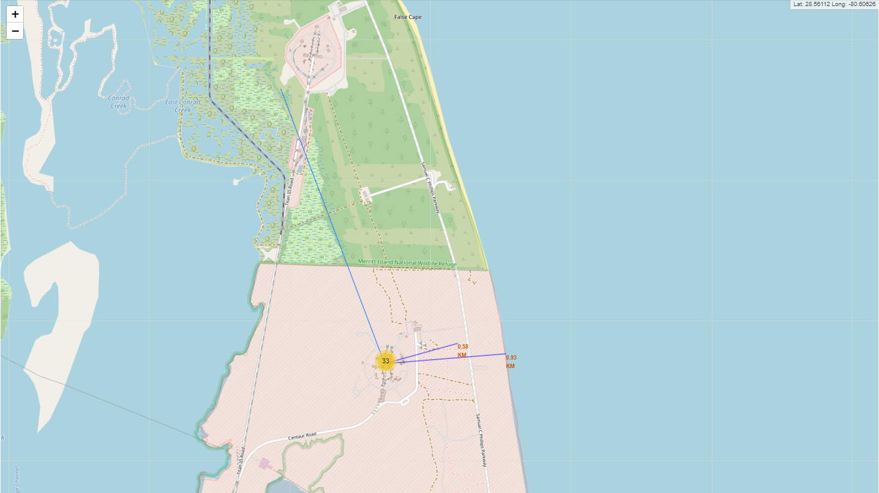
Map with calculated distance
It is an example of a folium map with calculated distance between the site CCAFS LC-40 and the coastline.
Objective folium.Marker and folium.Polyline are added.
Notes:
Replace <Folium map screenshot 3> title with an appropriate title
Explore the generated folium map and show the screenshot of a selected launch site to its proximities such as railway, highway, coastline, with distance calculated and displayed
Explain the important elements and findings on the screenshot

Slide 42

Section 4

Slide 43
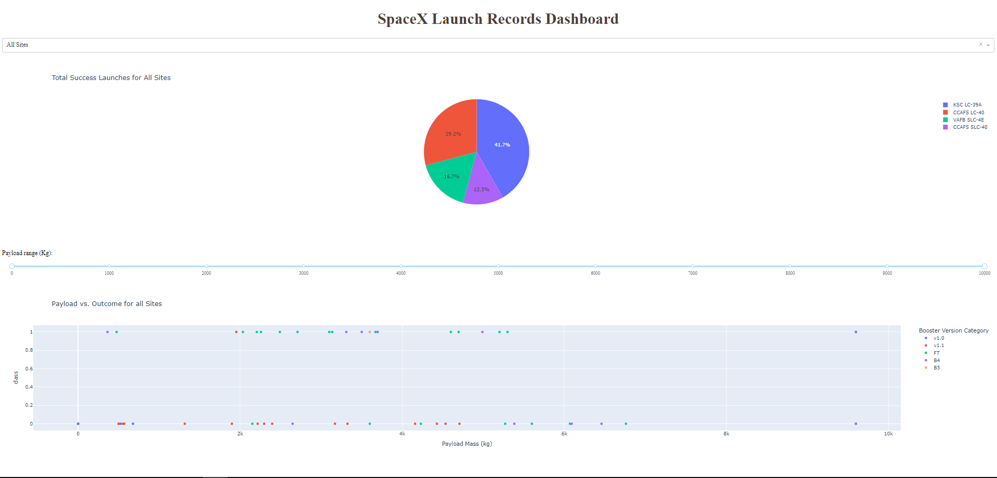
SpaceX Launch Records Dashboard – Total Success Launches for All Sites
Dropdown includes all launch sites
@app.callback includes component of “success-pie-chart”
KSC LC-39A 41.7%
CCAFS LC-40 29.2%
VAFB SLC-4E 16.7%
CCAFS SLC-40 12.5%
Notes:
Replace <Dashboard screenshot 1> title with an appropriate title
Show the screenshot of launch success count for all sites, in a piechart
Explain the important elements and findings on the screenshot

Slide 44
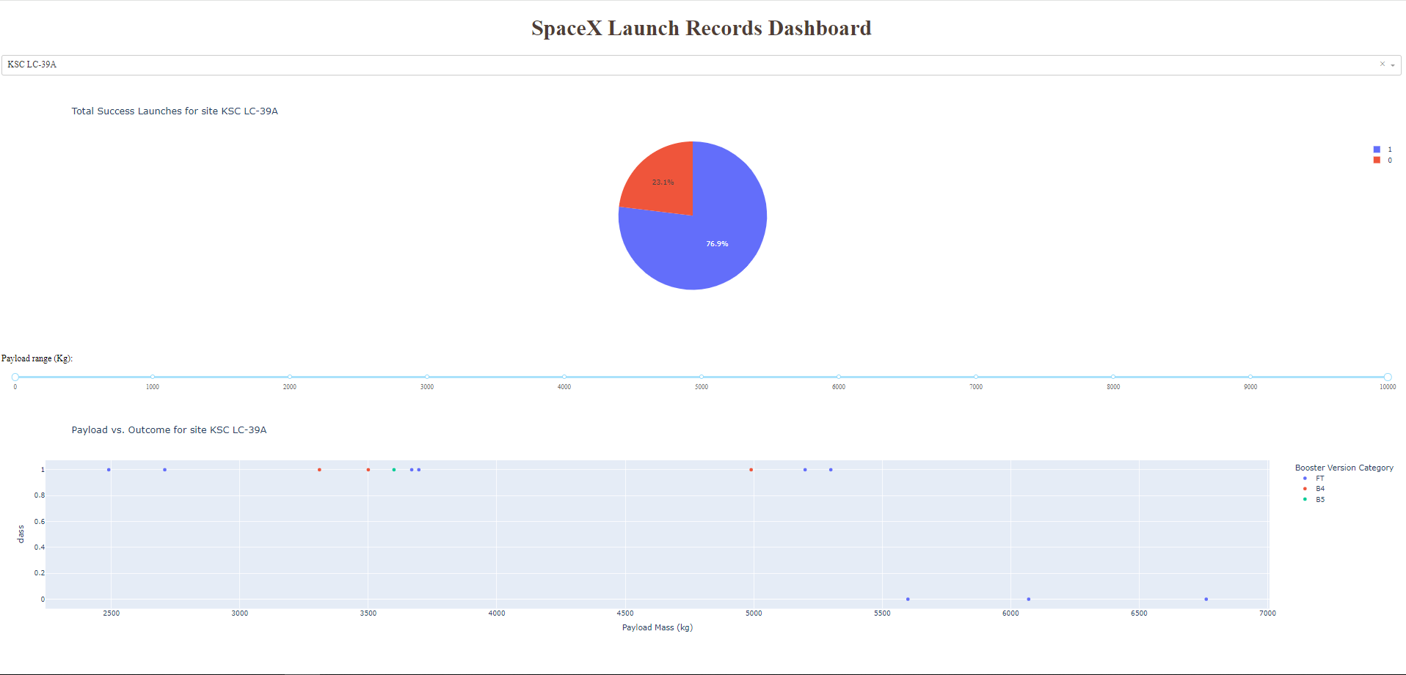
SpaceX Launch Records Dashboard – Site KSC LC-39A has the highest launch success ratio
Dropdown component that displays success/failed outcome % of each site
76.9% success outcome
23.1% failed outcome
Notes:
Replace <Dashboard screenshot 2> title with an appropriate title
Show the screenshot of the piechart for the launch site with highest launch success ratio
Explain the important elements and findings on the screenshot

Slide 45
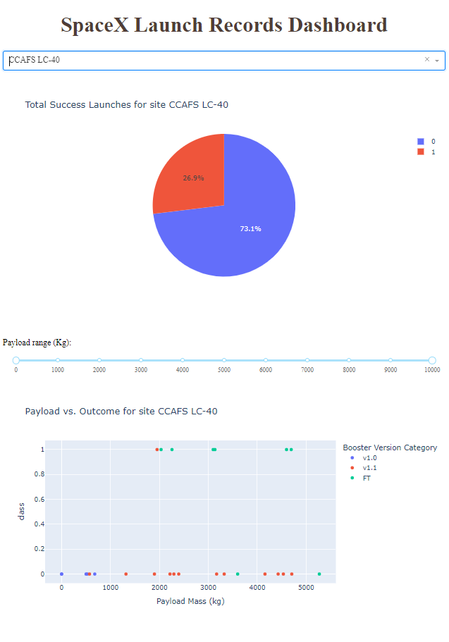
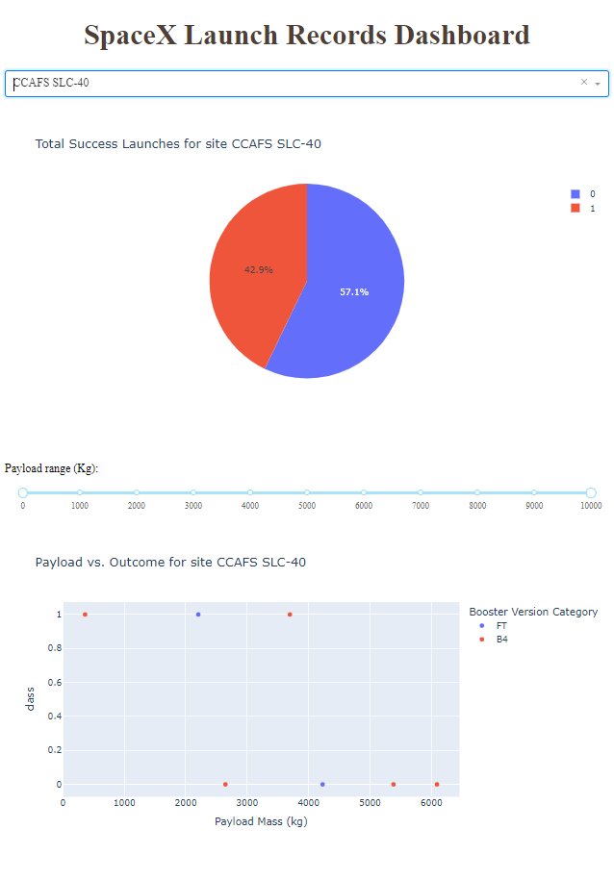
SpaceX Launch Records Dashboard – Payload vs Outcome range slider
@app.callback includes component of “success-pie-chart”
Site CCAFS LC-40
26.9% success
73.1% fail
Success occurs only with FT Booster Version with PayLoad Mass over 2000kg.
Site CCAFS SLC-40
42.9% success
57.1% fail
Success rate seems higher when PayLoad Mass is under 4000kg and it doesn’t seem to be dependent on Booster Version.
Notes:
Replace <Dashboard screenshot 3> title with an appropriate title
Show screenshots of Payload vs. Launch Outcome scatter plot for all sites, with different payload selected in the range slider
Explain the important elements and findings on the screenshot, such as which payload range or booster version have the largest success rate, etc.

Slide 46
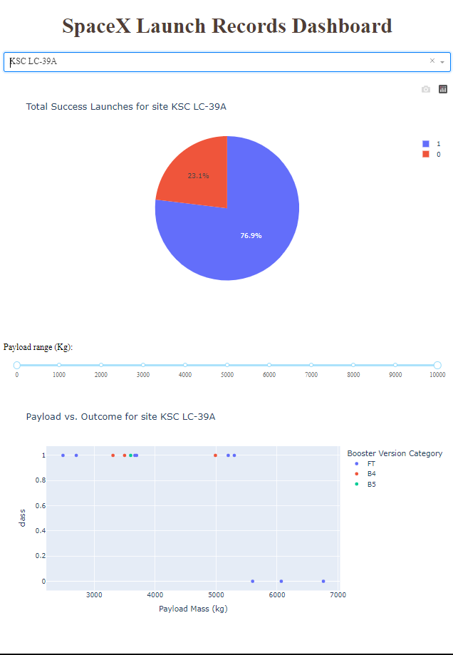
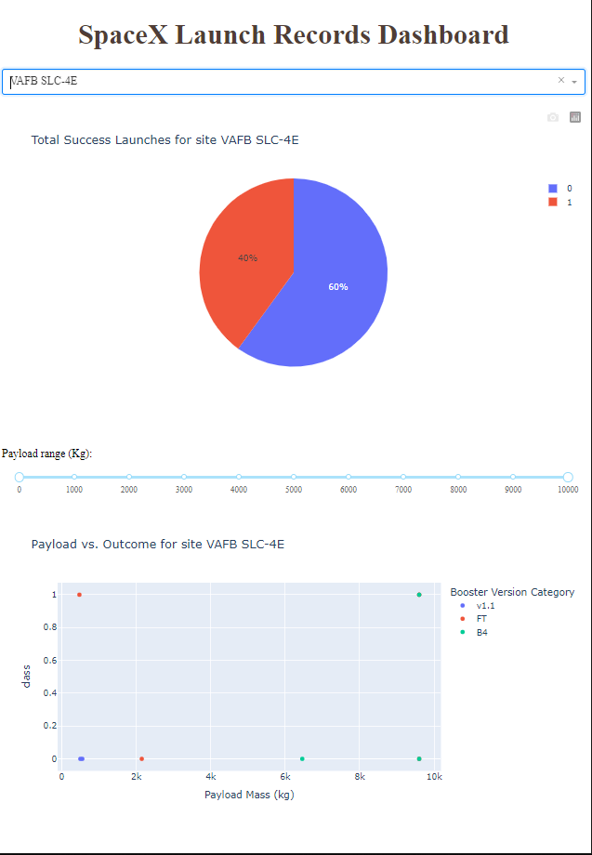
SpaceX Launch Records Dashboard – Payload vs Outcome range slider
@app.callback includes component of “success-pie-chart”
Site KSC LC-39A
23.1% success
76.9% fail
Success occurs only with PayLoad Mass under 5500kg and independent of Booster Version
Site VAFB SLC-4E
40% success
60% fail
Success and failure rate seem to be unrelated to PayLoad Mass nor the Booster Version.
Notes:
Replace <Dashboard screenshot 3> title with an appropriate title
Show screenshots of Payload vs. Launch Outcome scatter plot for all sites, with different payload selected in the range slider
Explain the important elements and findings on the screenshot, such as which payload range or booster version have the largest success rate, etc.

Slide 47

Section 5

Slide 48
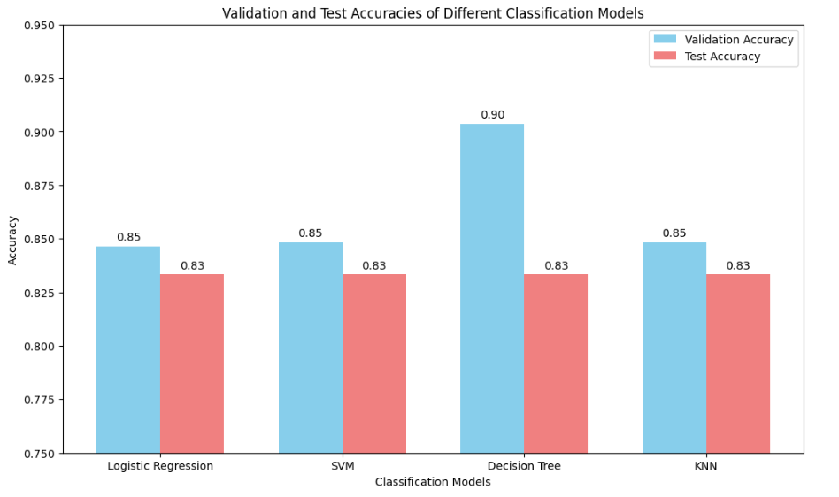
Classification Accuracy
Visualize the built model accuracy for all built classification models, in a bar chart

Slide 49
Classification Accuracy
Find which model has the highest classification accuracy:
All models gives the same model accuracy. However, the Decision Tree model gives the highest validation accuracy and hence is the best model according to the hyperparameters tuning results and validation accuracy.

Slide 50
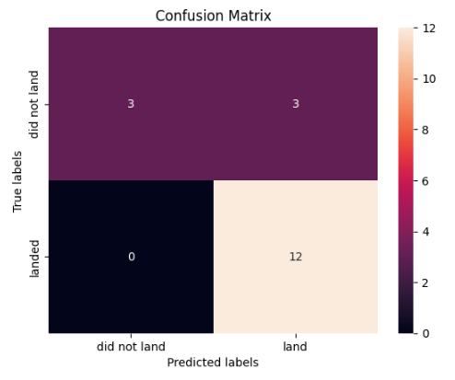
Confusion Matrix
Show the confusion matrix of the best performing model with an explanation
True Negatives (TN): 3 instances where the model correctly predicted "did not land.
"False Positives (FP): 3 instances where the model incorrectly predicted "land" when it was actually "did not land.
"False Negatives (FN): 0 instances where the model incorrectly predicted "did not land" when it was actually "land.
"True Positives (TP): 12 instances where the model correctly predicted "land.“
Accuracy = 15/18 X 100% = 83.3%

Slide 51
Conclusions
It is possible to collect the launch data through two ways i. SpaceX API ii. Webscraping with BeautifulSoap from Wikipedia.
Through the exploratory data analysis (EDA), the successful landing outcome is dependent on flight number, orbit, payload mass, site and Booster versions.
There are totally 56 launch sites and all are in the United States. All are next to the coast line.
The site KSC LC-39A has the highest successful rate.
Decision Tree model is the best model to predict the outcome of the launch.

Slide 52
Appendix
Include any relevant assets like Python code snippets, SQL queries, charts, Notebook outputs, or data sets that you may have created during this project
This is the GitHub repository including all the completed notebooks and Python files: https://github.com/ckmak9999/ibm_datascience_capstone

Slide 53


